Slide 1


DEPARTMENT OF ELECTRONICS AND COMMUNICATION ENGINEERING MINOR PROJECT II SMART SHOES FOR VISUALLY CHALLANGED PERSONS
PRESENTED BY:
ATHIL ABDUL RAHIM M
BHAGAVATHI R
DHANUSH S
BALAJI P
GUIDED BY:
Ms.S.VASUKI
Assistant Professor
Department of ECE

Slide 2
LIST OF CONTENT
ABSTRACT
INTRODUCTION
BLOCK DIAGRAM
BLOCK DIAGRAM DESCRIPTION
COST OF ESTIMATION
CIRCUIT DIAGRAM
CIRCUIT DIAGRAM DESCRIPTION
APPLICATIONS

Slide 3


ABSTRACT
The model discloses an intelligent shoe for the blind to go out.
The intelligent shoe comprises a vamp and a sole. The front end of the sole is provided with an ultrasonic sensor.
The ultrasonic sensor is connected with a micro motor.
The intelligent shoe has the characteristics that the intelligent shoe has an obstacle avoidance function.

Slide 4
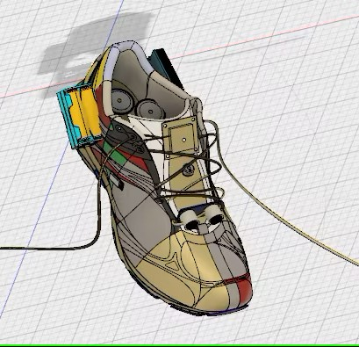
INTRODUCTION
Smart shoes is a smart footwear technology. That uses the ultrasonic sensor and Arduino nano for sensing the object, thus it help the blind persons to move or travel safely

Slide 5
MATERIALS REQUIRED
Arduino nano
Battery
Shoes
Ultrasonic sensor
Vibrating motor
Connecting wires

Slide 6
BLOCK DIAGRAM
ULTRASONIC SENSOR
ARDUINO NANO
BUZZER
VIBRATING MOTOR

Slide 7
Ultrasonic sensors work by emitting sound waves at a frequency too high for humans to hear. They wait for the sound to be reflected back, calculating distance based on the time required. This is similar to how radar measures the time it takes a radio wave to return after hitting an object.
The Arduino software includes a serial monitor which allows simple textual data to be sent to and from the Arduino board. The RX and TX LEDs on the board will flash when data is being transmitted via the FTDI chip and USB connection to the computer

Slide 8
A buzzer or beeper is an audio signaling device, which may be mechanical, electromechanical, or piezoelectric (piezo for short). Typical uses of buzzers and beepers include alarm devices, timers, train and confirmation of user input such as a mouse click or keystroke.
The improperly balanced force causes a high-level speed displacement in the motor and this creates vibration. The generated centrifugal force creates vibration in the motor and allows the motor to vibrate in the X and Z axis.

Slide 9
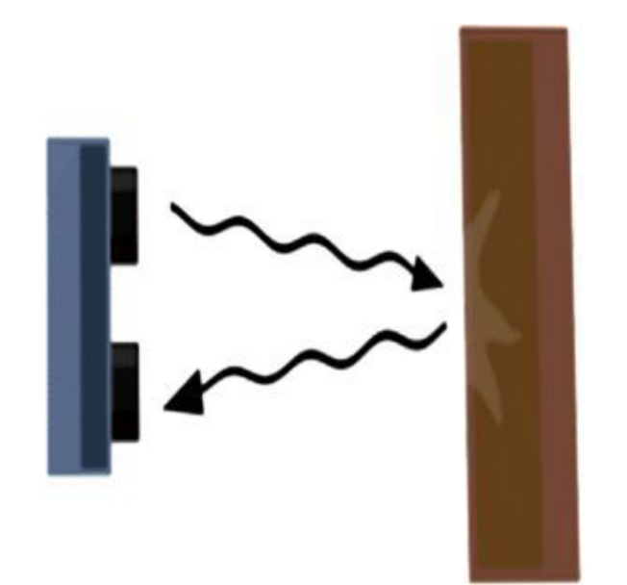
WORKING OF OBSTACLE DETECTOR
The obstacle sensor senses the object upto from 4 meters
Transmitter part of sensor emits the signal
Distance of object from user is detected at receiver
The signal from receiver end passes indication to vibrating motor and buzzer

Slide 10
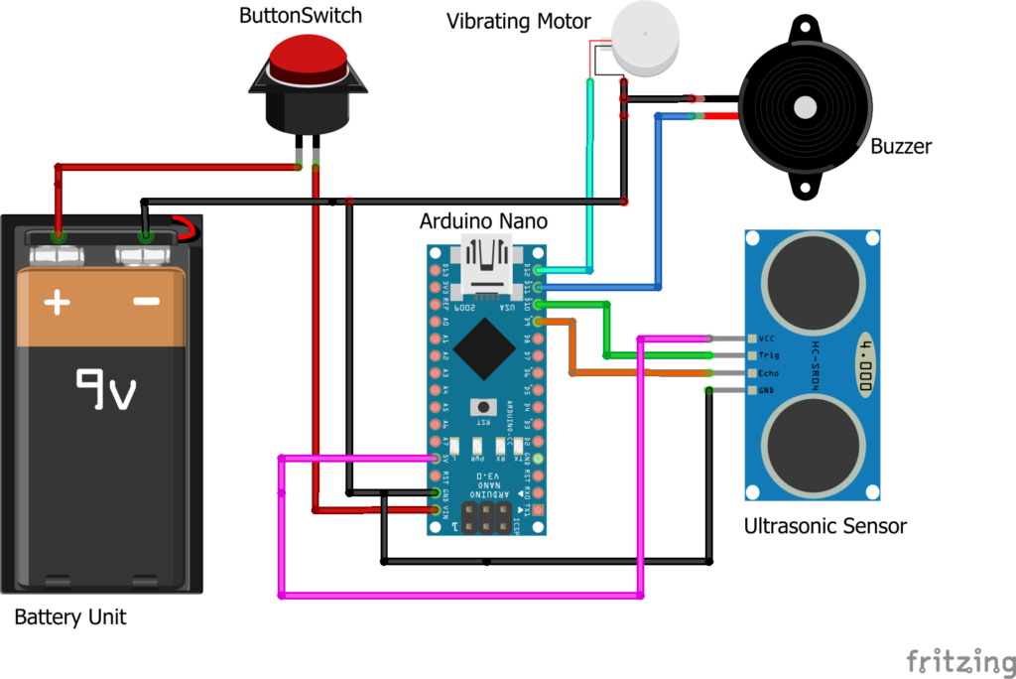
CIRCUIT DIAGRAM

Slide 11
CIRCUIT DIAGRAM DESCRIPTION
The Arduino nano is coded with the suitable varying of the battery.
In this project , we are using ultrasonic sensor.
The ultrasonic sensor is connected with Arduino nano.
When the object comes near to the sensor ,the sensor detect the object by sensing then it remindes the person by producing alarmatic sound by buzzer.

Slide 12
The circuit also contains a vibrating sensor or motor connected with Arduino board.
The vibrating motor plays a couple of significant role in the circuit ,
i) Senses the instruction from the Arduino
nano and indicate the buzzer
ii) Directly sense the user by a vibration in
the case of the user is also having hearing
impairment

Slide 13
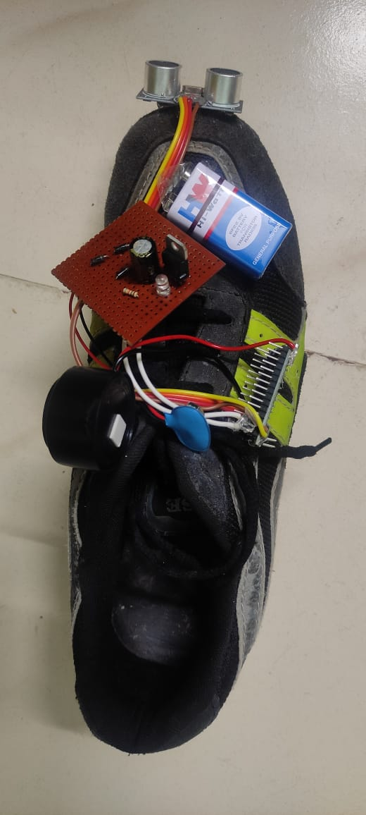

Slide 14
ADVANTAGES
The smart shoe will help the blind person to reach his destination independently
The shoe will make a noise with buzzer when the person walks in front of an obstacle

Slide 15
CONCLUSION
We would like to conclude that the proposed system completed successfully. As we stated earlier in a problem statement, the previous problem like a less information conveyed, poor efficiency of IR sensor and dependency on stick are overcome and successfully implemented with efficiency of object detection and with clear information to a blind people for their guidelines.

Slide 16
FUTURE SCOPE
In future this intelligent shoe will be act as the pivotal and needful object for the visually impaired peoples
The AI(Artificial Intellingence) concept will be introduced in this to develop this project to the next level

Slide 17
COST OF ESTIMATION
ARDUINO NANO 1 1000
BATTERY 7.4v 1 700
ULTRASONIC SENSOR 1 600
SHOES 1 600
WIRES AS REQUIRED 100
TOTAL = 3000

Slide 18
THANK YOU

